Slide 1





7th IEEE International Conference INDISCON 2026
Paper Title:- XYZ Paper ID:- XYZ Authors Name-XYZ
Presented by: Name, Affiliation
7th IEEE International Conference INDISCON 2026, 11th – 13th September 2026 | MNIT Jaipur, India

Slide 2
Presentation Outline
Introduction
Background
Proposed Work
Dataset Description
Performance Measures
Results and Analysis
Conclusion and Future Scope
References
7th IEEE International Conference INDISCON 2026, 11th – 13th September 2026 | MNIT Jaipur, India

Slide 3
Introduction
Behavioral and Data Trust Management Scheme for IoT
Trust is a measurable belief.
Trust is directed.
7th International Conference MIND-2025, 12th – 14th December 2025 | MNIT Jaipur, India
7th IEEE International Conference INDISCON 2026, 11th – 13th September 2026 | MNIT Jaipur, India

Slide 4
Background
Basic Properties of Trust Relations
Trust
Reliance on the character, ability, strength, or truth of someone or something
7th IEEE International Conference INDISCON 2026, 11th – 13th September 2026 | MNIT Jaipur, India

Slide 5
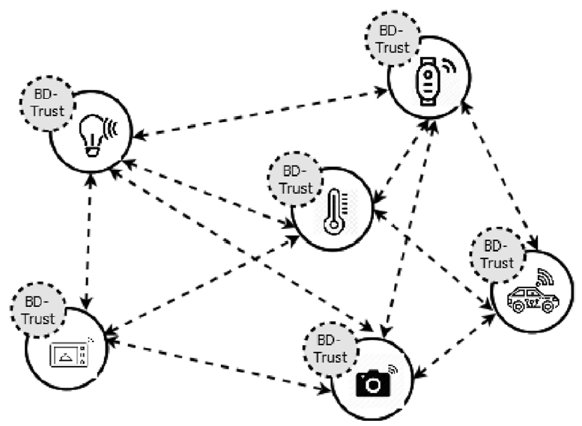
Proposed Work
Influence of previously observed trust + recent observations
to effectively capture dynamics of devices.
Fig. 1: ZZZ Model
7th IEEE International Conference INDISCON 2026, 11th – 13th September 2026 | MNIT Jaipur, India

Slide 6
Proposed Work
Computation Module
The value of trust at time t for
Window Δt with Nij transactions
7th IEEE International Conference INDISCON 2026, 11th – 13th September 2026 | MNIT Jaipur, India

Slide 7
Dataset Description
The dataset comprises 36 recording of multichannel EEG corresponding to 36 subjects at the time of mental arithmetic task. Out of 36 subjects, 26 are Good Counter and 10 are Bad Counter.
The EEG signal is recorded with the help of a device named Neurocom Monopolar EEG 23-channel system.
The EEG signals are recorded for 61 seconds with a sampling frequency of 500 Hz
The shape of the matrix for a single subject is 19*31000. The shape of the matrix is reshaped. The new shape of the matrix is 760*775 where each channel’s signal is divided into 40 equal parts and arranged consecutively to form the new shape. This is done to make shape of the matrix symmetric
7th IEEE International Conference INDISCON 2026, 11th – 13th September 2026 | MNIT Jaipur, India

Slide 8
Performance Measures
There are different performance measures used to compare the different architectures of CNN, such as Accuracy, Precision, Recall, Area Under Curve, and F1-score.
Accuracy (ACC):
ACC = (TP + TN) / (TP + TN + FP + FN), (1)
Precision (PR)/ (Positive Predictive Value (PPV)):
TPR = TP / (TP + FP), (2)
7th IEEE International Conference INDISCON 2026, 11th – 13th September 2026 | MNIT Jaipur, India

Slide 9
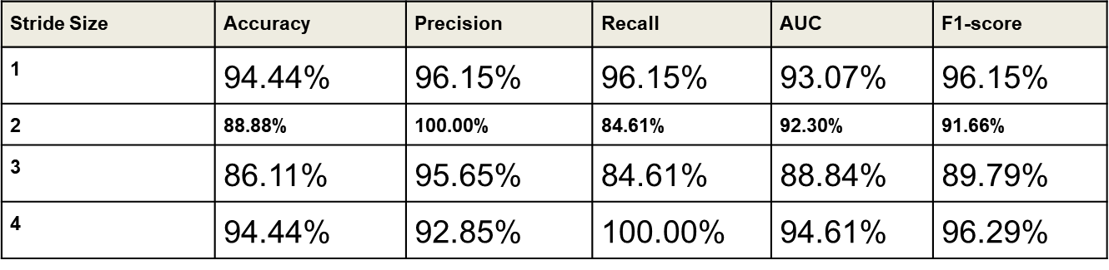
Results and Analysis
Table 1. Performance Measures for numbers of filters 32 in the architecture
7th IEEE International Conference INDISCON 2026, 11th – 13th September 2026 | MNIT Jaipur, India

Slide 10
Conclusions and Future Scope
In this study, a single convolution layer based 2D-CNN architecture is used to classify total 36 subjects into Good counter and Bad counter based on the EEG signals recorded during mental task.
The various parameters of CNN like no. of filters, kernel size, and stride length are varied to find the optimum architecture which gives the best performance.
The best accuracy of 97.22% is achieved for kernel size 3, no. of filters 16, and stride size 2 when using hold-out validation. The same architecture when used with leave-one-subject-out validation gives accuracy of 94.44%.
In future this work will be extended using data augmentation techniques for generating new data samples in order to make number of samples balanced in both the classes.
7th IEEE International Conference INDISCON 2026, 11th – 13th September 2026 | MNIT Jaipur, India

Slide 11
References
7th IEEE International Conference INDISCON 2026, 11th – 13th September 2026 | MNIT Jaipur, India

Slide 12
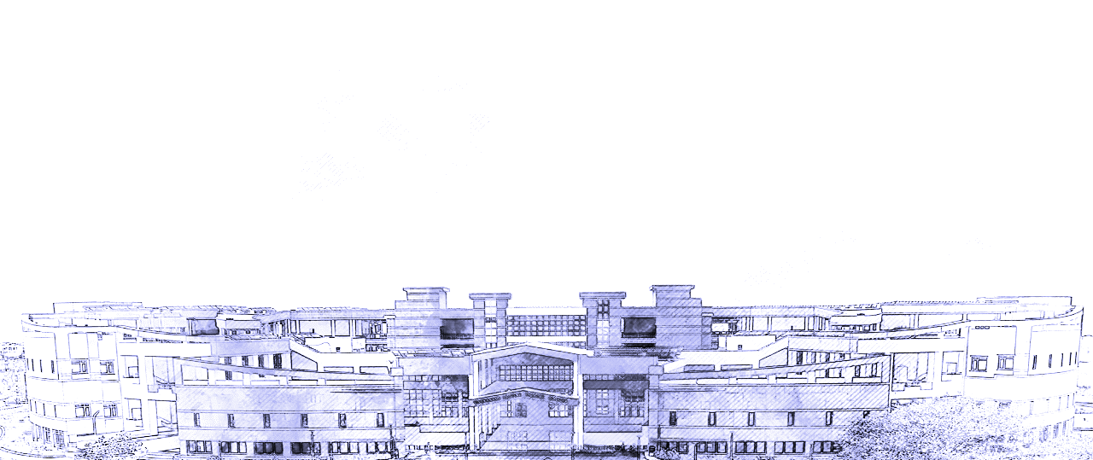
THANK YOU

